Slide 1
Code Transformation
Old -> New via implementing an interface

Slide 2
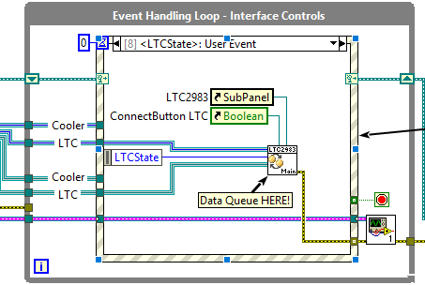
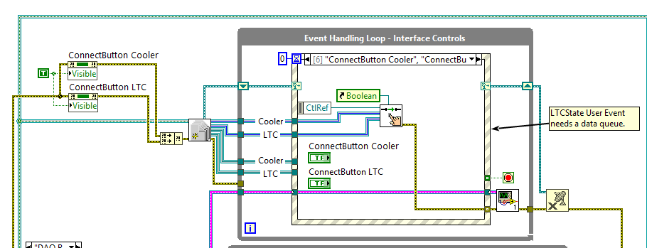
Initially:
Notes:
Next slide is the subVI in the upper right image.
Even though this is only a small part of the system, already lots of hidden detail (multiple frames, states, etc)

Slide 3
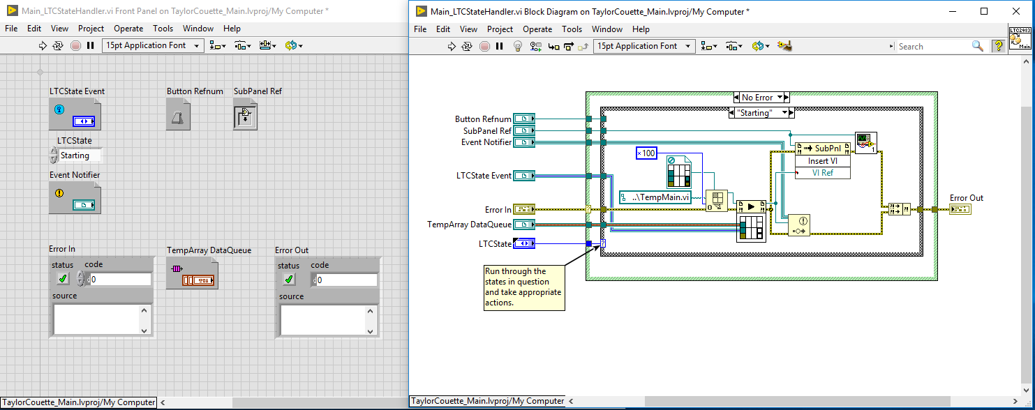
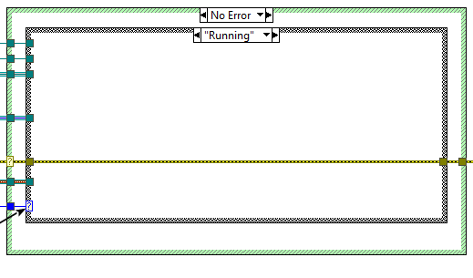
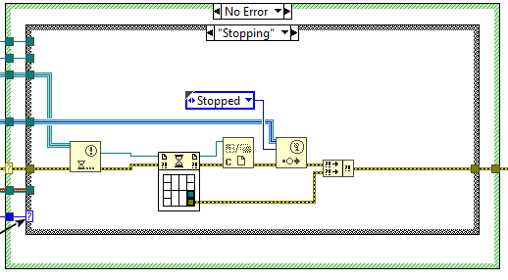
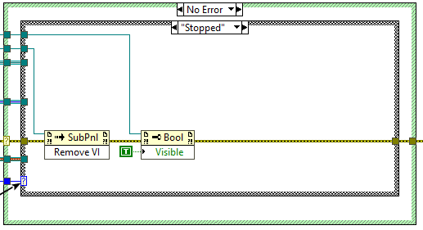
Notes:
Calls the VI asynchronously – this is something that is more easily provided by the Actor Framework (to be discussed)

Slide 4
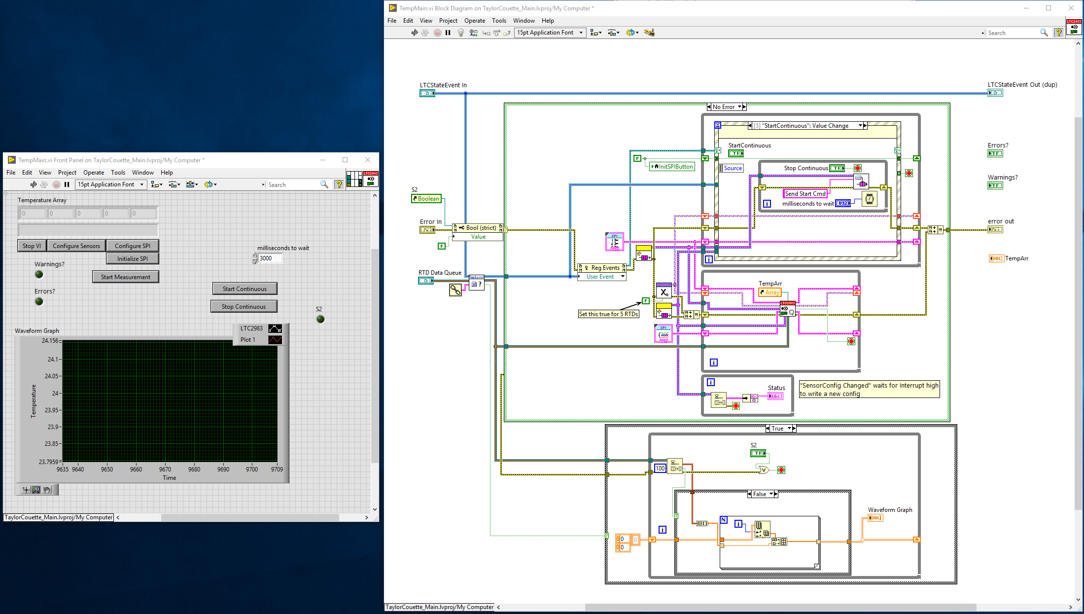
Notes:
This is the VI being called asynchronously. The three sections are an event handler (for the front panel events, and the queue driven events), an command handler in the centre, and the graph display at the bottom.
In a way that will become common as a theme through this presentation, the important bit is easily missed because the VI gives much more space to side-activities… Try to emphasise the purpose in each VI (or at least, minimize distractions).

Slide 5
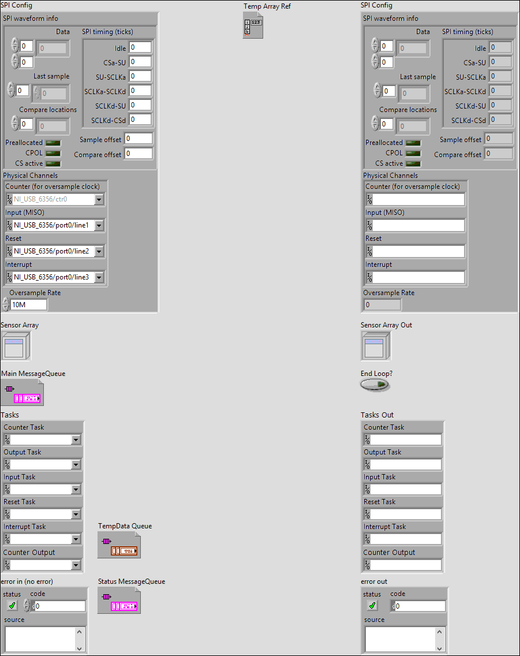
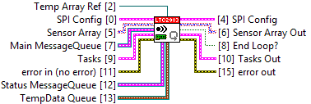
Notes:
These next slides are the output from the “Print” command used on the main subVI. The wiring diagram is immediately horrible…

Slide 6
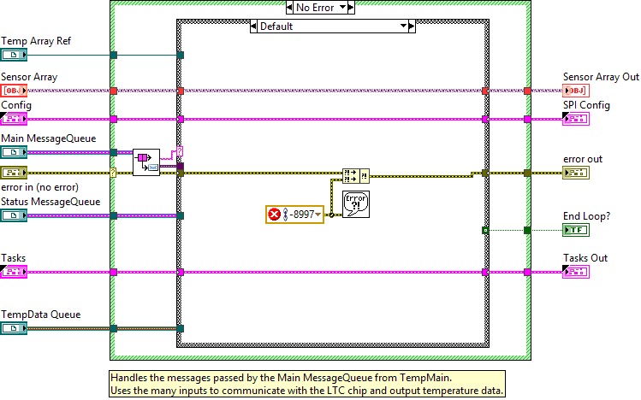
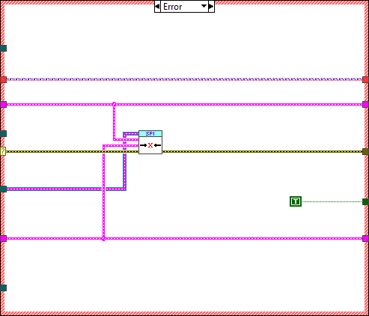
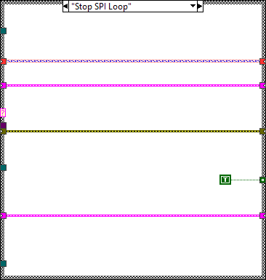
Notes:
Here, handles unexpected messages, and disconnects on error. (Stop loop in bottom right)

Slide 7
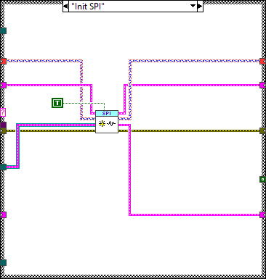
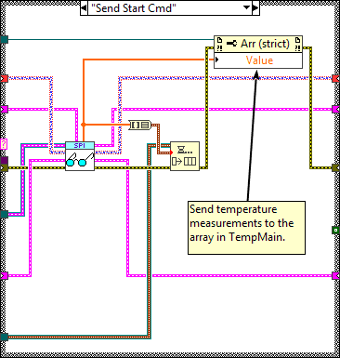
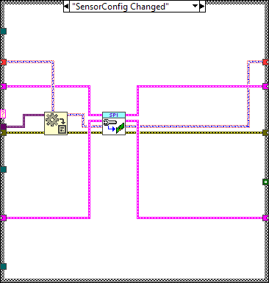
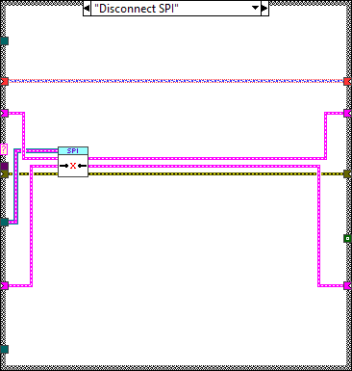
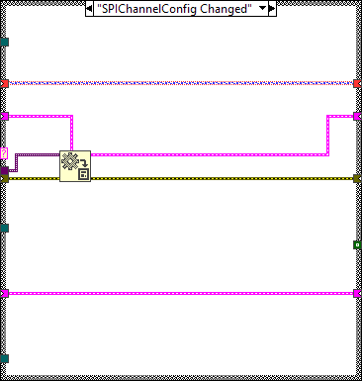
Notes:
These are the remaining frames of the case structure. They each take some of the inputs (only one uses all) and then call some subVI.
The central VI is the one which reads the temperature, and which we will be looking at a wrapper for next.

Slide 8
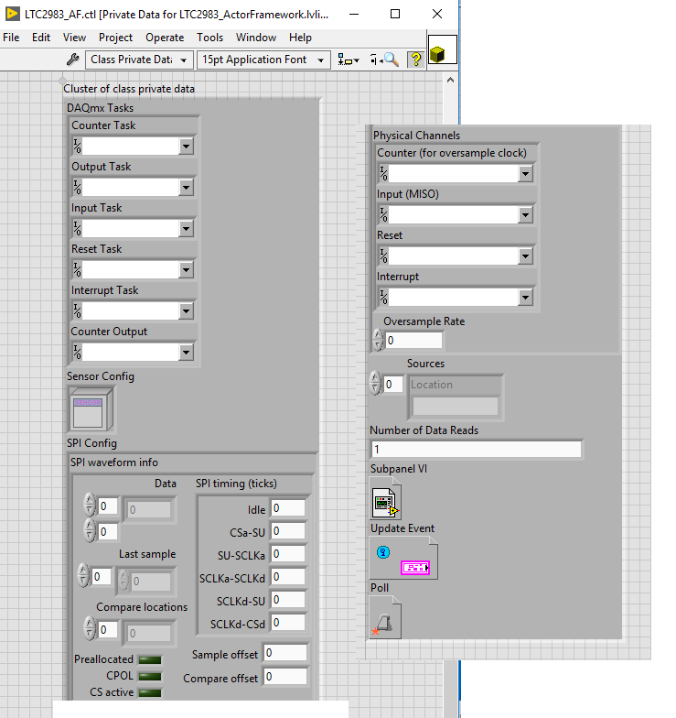
That moved to this: (a thin wrapper)
Moved the previous clusters into the class private data
Created wrappers for each of the main operations
Added some additional code to try and make the measurements more consistent, or to fit into the rest of the new application
Notes:
This class still has all of the same data – which is really too much!
However, now it’s a little easier to pick out the items I need for a given subVI, and refactoring to reduce the spaghetti becomes more possible.
There are some additional data members (Nreads, Subpanel reference, Update Event, “Poll”) but the idea is similar.

Slide 9
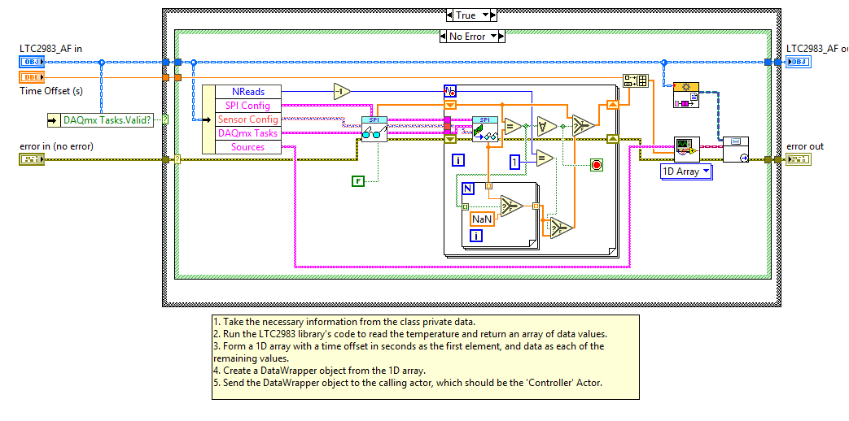
The “Measure Temperature” wrapper
Notes:
This is where I’m going to start this refactoring/rearranging – I have placed some of the “low-level” VIs inside these wrapping functions and I want to make them clearer so they can be more easily used with my Measurement interface.
Here, it looks like the important things are in the For loop, whilst really it never runs!

Slide 10
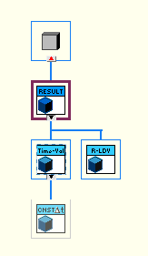
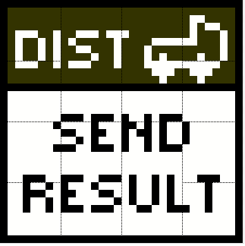
Some supporting pieces:
Measurement Results
The LTC measurement will produce a “Time-Value” result and package with it some information about the measurement, such as time, location and name.
Result Distributor
Initially, I will use a “Distributor” which just wraps the original functionality.
In the future, this inheritance hierarchy will allow me to change the method for passing data, or allow reuse in other systems.
Notes:
This is an example that can be made because of the Results hierarchy we’ve previously discussed – all of my Measurements can create Results objects, which can then be passed to a Distributor
By being able to independently vary the Distributor, I can control how data is passed in the system (without introducing additional dependencies to the Measurements – they depend only on the interface class, which does nothing).

Slide 11
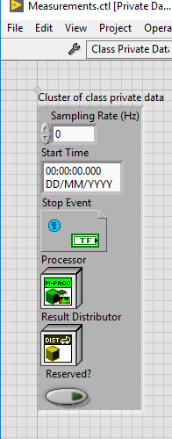
The Measurement Interface
API (public interface):
InitMeasurementActor.vi
SingleMeasurement.vi
StartMeasurement.vi
StopMeasurement.vi
UpdateStartTime.vi (might change this…)
Protected interface:
Process.vi
Read Rate.vi (uncertain…)
RegisterForStop.vi
Reserve.vi
Release.vi
Send Result.vi
Notes:
The API are the actions I believe any Measurement should be able to fulfil.
The Protected interface is the list of VIs, some of which are static dispatch, that can be used by children to help carry out those actions. These cannot be called from outside of the classes.

Slide 12
First steps…
I moved the code to connect to the hardware into a “Reserve” override, and the code to disconnect into the “Release” override.
This allowed me to delete “Stop Core.vi” and tidy up the beginning of “Actor Core.vi”
It separates out stopping and starting the actor from connecting and disconnecting to the hardware – this makes the code more flexible.
Notes:
Describe the purpose of Stop Core and Actor Core, and the flow of the Actor Framework at a high level (PreLaunchInit, AC, SC)
Can start from “workingLTC-rewriteAsMeasurement” and finish this slide at “p0” tags.

Slide 13
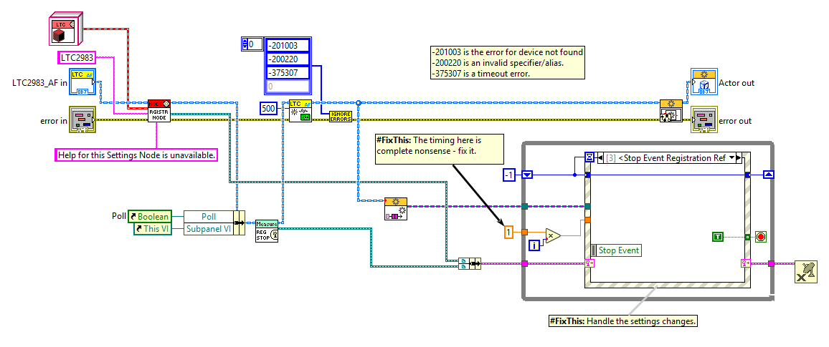
Actor Core.vi
Notes:
Before – the Actor Core VI

Slide 14
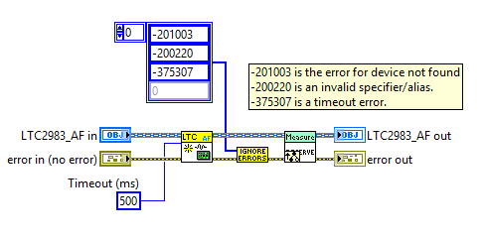
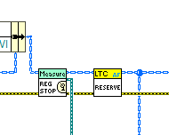
Reserve.vi + calling Reserve from Actor Core
Notes:
Just copied the code from Actor Core into Reserve (created via From Override) and then placed this in the Actor Core.
In this way, it’s only using it as a simple SubVI – done to preserve behaviour.
In future, this can be removed once the VI is called via a hierarchy to make it behave like a Measurement Actor.
There’s an error here – should remove the errors afterwards, or else “Reserved?” will be set to true in the parent unconditionally!
Discuss how the functionality in the parent implementation can make it harder to write the child correctly.

Slide 15
A more complicated transformation…
Next, I want to implement the “SingleMeasurement.vi” override.
This will more-or-less wrap “MeasureTemperature.vi”
Notes:
SingleMeasurement should make a measurement, record the time, and send a Measurement Result object with all the relevant information to the Distributor.
In the starting case, I want to make it behave exactly like it does now!
First, we’ll get rid of the For loop in the middle – this is not relevant to the normal operation and is a lower level construct (like the error codes)
Work through in LabVIEW: start with MeasureTemperature_old.vi and try create a subVI. Note the large number of inputs, and how they’re all available via the class.

Slide 16
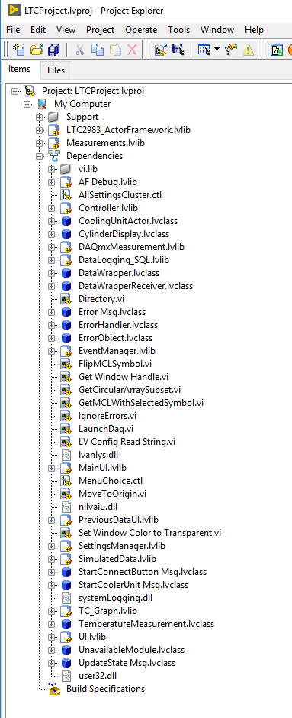
Dependencies of the LTC Actor class
Some highlights:
UI.lvlib
ErrorHandler.lvclass
Controller.lvlib
DataWrapper.lvclass
CoolingUnitActor.lvclass (!!)
LaunchDaq.vi (!!)
SimulatedData.lvlib
Notes:
Some of these are not inherently unreasonable – maybe directly coupling to the Error Handler is OK.
Some are ridiculous! How does LTC depend on a global VI in a different call chain, or SimulatedData/CoolingUnitActor (answer, probably a shared typedef!)
Reducing coupling will improve load times and improve chances of reuse elsewhere (example, a different experiment using the same hardware for this, but changing other parts).

Slide 17
Dependencies of the LTC Actor class
Some highlights:
UI.lvlib
ErrorHandler.lvclass
Controller.lvlib
DataWrapper.lvclass
CoolingUnitActor.lvclass (!!)
LaunchDaq.vi (!!)
SimulatedData.lvlib
Notes:
Some of these are not inherently unreasonable – maybe directly coupling to the Error Handler is OK.
Some are ridiculous! How does LTC depend on a global VI in a different call chain, or SimulatedData/CoolingUnitActor (answer, probably a shared typedef!)
Reducing coupling will improve load times and improve chances of reuse elsewhere (example, a different experiment using the same hardware for this, but changing other parts).

Slide 18
Adding a child allows simple testing!
Finally, we can now add a child, override just one method, and have a ‘working’ test

